Slide 1
Strategies for Teaching Information Literacy to English Language Learners
LILAC Spring Training at CUNY Central, June 8, 2018
Selenay Aytac, Long Island University
Clara Y. Tran, Stony Brook University

Slide 2
Objectives
Support academic librarians
  Meeting challenges of teaching information literacy to English Language Learners (ELLs)
Provide effective strategies
  Teaching information literacy skills to ESL students
Notes:
How presentation will benefit audience: Adult learners are more interested in a subject if they know how or why it is important to them.
Presenter’s level of expertise in the subject: Briefly state your credentials in this area, or explain why participants should listen to you.

Slide 3

Introduction
International Student Enrollment
  567,039 (2008/2009) vs 903,127 (2016/2017)
  59% increase
Diverse group of student populations
Adapt a new learning environment
https://www.iie.org/Research-and-Insights/Open-Doors/Data/International Students/Enrollment
Courtesy of southwest.tn.edu
Notes:
How presentation will benefit audience: Adult learners are more interested in a subject if they know how or why it is important to them.
Presenter’s level of expertise in the subject: Briefly state your credentials in this area, or explain why participants should listen to you.

Slide 4
Literature Review
International Students’ Challenges
  Anxiety (Conte-Morgan, 2001; Kim, 2015; Park, Klieve, Tsurutani, & Harte, 2017)
  Accented English (Park et al., 2017)
  Language barrier (Mu, 2007; Cowles, 2012)
  Cultural differences (Mu, 2007; Cowles, 2012)
Notes:
How presentation will benefit audience: Adult learners are more interested in a subject if they know how or why it is important to them.
Presenter’s level of expertise in the subject: Briefly state your credentials in this area, or explain why participants should listen to you.

Slide 5
Literature Review
Librarians’ Challenges
  Have little or no training in the most effective methods for working with ELLs
  May not have a Master’s in Education (M.Ed) or Master of Arts in Teaching (MAT)
  Need to learn some teaching theories, strategies, and pedagogies (Conteh-Morgan, 2002)
    Support ELLs academic success
Notes:
How presentation will benefit audience: Adult learners are more interested in a subject if they know how or why it is important to them.
Presenter’s level of expertise in the subject: Briefly state your credentials in this area, or explain why participants should listen to you.

Slide 6
Literature Review
Librarians’ Roles:
  Make ELLs students feel secure and welcoming by libraries (Adams, 2010)
  Promote library (Mu, 2007)
  Work closely with ESL instructors to enhance international students’ IL skills (Conte-Morgan, 2001)
  Assist with systematic intervention during the research process to lessen students’ frustration (Kim, 2015)
Notes:
How presentation will benefit audience: Adult learners are more interested in a subject if they know how or why it is important to them.
Presenter’s level of expertise in the subject: Briefly state your credentials in this area, or explain why participants should listen to you.

Slide 7
Literature Review
Collaboration
  Work with teaching faculty to understand the research and information needs of 1st year international students (Cooper & Hughes, 2017)
Innovative Instructional Models
  Use of an ESL instructor in charge to teach IL (Conteh-Morgan, 2001)
  Include pronunciation instructions (Park et al.)
  Flipped classroom (Johnston & Karafotias, 2016)
  Scaffolding learning (Mehring, 2016)
  Embedded in online course (Lombard, 2016)
Notes:
How presentation will benefit audience: Adult learners are more interested in a subject if they know how or why it is important to them.
Presenter’s level of expertise in the subject: Briefly state your credentials in this area, or explain why participants should listen to you.

Slide 8
Literature Review
Teaching Strategies
  Vocabulary learning (Mokhtar et al., 2017)
    Students recall words and apply them
  Teach students the scanning techniques (Johnston et al., 2014)
    To discover more reliable research articles
  Connect IL instruction through ESL instructors’ writing and speaking instruction approaches in ESL classes (Bordonaro, 2015)
Notes:
How presentation will benefit audience: Adult learners are more interested in a subject if they know how or why it is important to them.
Presenter’s level of expertise in the subject: Briefly state your credentials in this area, or explain why participants should listen to you.

Slide 9
Literature Review
Teaching Strategies
  Motivate ELLs to create digital storytelling (Green, 2013)
    Help with the use of language
  Use of CD-Room, short video clips, and interactive exercises (Klapwijk and Du Toit , 2009)
  Apply multiple strategies (Mokhtar et al., 2017)
Notes:
How presentation will benefit audience: Adult learners are more interested in a subject if they know how or why it is important to them.
Presenter’s level of expertise in the subject: Briefly state your credentials in this area, or explain why participants should listen to you.

Slide 10
Scaffolding strategies
Scaffolding strategies can be beneficial to teaching librarians in order to focus and illustrate better understanding of information literacy (IL) practices
According to Vygotsky (1962), scaffolding is an interactive process in which a teacher assists learners to build a ‘structure’ to contain and frame the new information.
The scaffolding metaphor originates from Vygotsky’s idea of Zone of Proximal Development (ZPD) which lies in the social constructivist theoretical tradition. According to ZPD there is a difference between what a learner can do without help and can do with help.
If we apply ZPD into the IL framework, we see that the ZPD is the distance between what students can do by themselves and the learning that they can be helped to achieve with competent IL instruction provided by a librarian
Notes:
How presentation will benefit audience: Adult learners are more interested in a subject if they know how or why it is important to them.
Presenter’s level of expertise in the subject: Briefly state your credentials in this area, or explain why participants should listen to you.

Slide 11
Figure 1. The ZPD in IL instruction.
What the ELLs dont know
What the ELLs can learn with scaffolded IL instruction
Background Knowledge

Slide 12
How can we transform the IL instruction with Vygotskian ideas?
First of all, planning for IL instruction should be built on two salient features:
  using background knowledge of our students and
  setting excellent objectives.
Notes:
How presentation will benefit audience: Adult learners are more interested in a subject if they know how or why it is important to them.
Presenter’s level of expertise in the subject: Briefly state your credentials in this area, or explain why participants should listen to you.

Slide 13
Background Knowledge
This can be perhaps one of the crucial stages of IL lesson preparation. In order to assess background knowledge of our students, we can use through questioning. For instance, we can pose the following questions to our ELLs prior to plagiarism instruction:
  Have you ever heard of the concept of plagiarism?
    Could you please give us an example?
Have you ever seen anyone doing this prior to coming to the US to study?
Notes:
Lesson descriptions should be brief.

Slide 14
The KWL Chart
the KWL Chart is a great way to know what our students already know about the content, background knowledge, and what they would like to learn.
By using this strategy we can ignite the background knowledge and connect that with our IL lesson plan
KWL charts are great way to assess what we taught in a very short period of time.
A good use of a KWL chart can be during the one shot introduction to the library lesson plan for our ELLs.
Notes:
Example objectives
At the end of this lesson, you will be able to:
Save files to the team Web server.
Move files to different locations on the team Web server.
Share files on the team Web server.

Slide 15
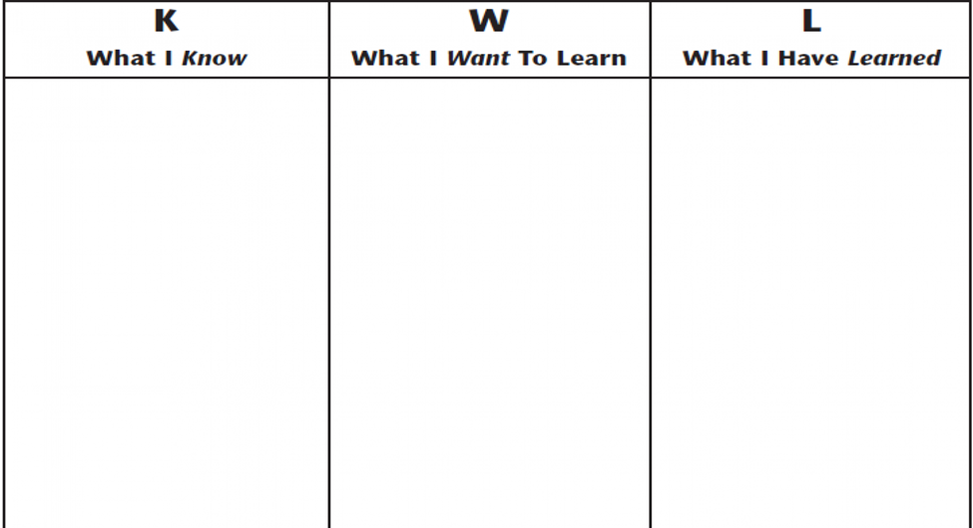
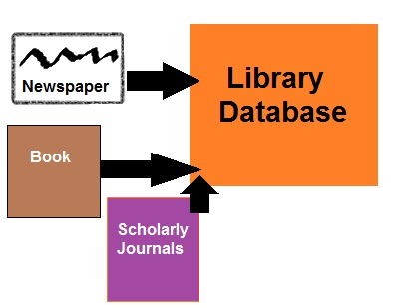


The KWL Chart
What do we Know about our Library?
What we Want to learn about our Library?
And at the end of the lesson: What we did Learn?

Slide 16
Visual Aids
Just like KWL charts, graphic organizers and pictures can all serve as scaffolding tools.
Graphic organizers are very specific in that they can help our students to grasp IL concepts such as citing, and citing correctly according to a citation style such as MLA or APA.
Graphic organizers can be used when we introduce the citation styles to spell out all the bibliographic elements and teach the sequence of them according to a given style.
Various kinds of visuals including pictures, diagrams, and illustrations are essential to a good IL instruction.

Slide 17
Realia
Realia is a term for real things that are used in IL instruction to build background knowledge and new vocabulary. Realia is one of the most popular strategies used for decades in IL instruction.
The main advantage of using realia in the IL classroom is to make the learning experience more sensory for the ELLs.
For instance, if you are going to teach what is a peer reviewed or scholarly journal article you can bring copies of journal articles to the instruction lab. Students can touch and feel the new type of resource at the same time as hearing the new concept.

Slide 18
Word Wall
A word wall in the IL instruction is a powerful tool to strengthen new vocabulary skills for ELLs.
A word wall can be an organized collection of words (and sometimes phrases) displayed on a wall or other space in the classroom.
An example of a word wall activity and the rubric can be seen in below where students asked to play a special game called “Library Lingo” which is similar to the known game “Bingo.”
The purpose of this game to introduce the new vocabulary by using gaming. Library Lingo cards are distributed among the students.
L I B R A R Y
L | I | N | G | O
Library Homepage | Periodical(s) | Bibliography | Scholarly | Journal(s)
Database(s) | Citation Styles | FREE | References | Volume
Online Catalog | Full-text | Issue | Magazine(s) | Author
Article | Abstract | Newspaper(s) | Citation Styles | Publisher

Slide 19
Word Wall
The second example of a word wall can be seen below in “Library Word Wall” in which we use all the newly acquired terminology to create a word wall together with the ELLs.
Here we use the black board and smart board.
While we are marking the new words on the Smart Board, we are creating the word wall on the left by using the blackboard. It is crucial that the ELLs can see the newly acquired vocabulary both on the wall and in their handouts.

Slide 21
Word Wall
Pre-teaching vocabulary can take a place prior to the instruction in numerous ways.
A list of new vocabulary can be presented to each student as a print out and ELLs can be asked to read and research the meaning of the concepts within 5 minutes.
Or the librarian can assign students into a group and assign the concepts to each group to discuss prior to the instruction.
If we can form the groups based on students’ prior knowledge, we can get a powerful 5 minutes of a pre-loading vocabulary session.
Another way to expose ELLs to the new vocabulary is to provide a page of new IL concepts to their ESL teachers. ESL teachers can use this new vocabulary in the ESL classroom and prepare the students for this very important and demanding IL session. With the dozen or so words front-loaded, ELLs are ready to tackle that challenging plagiarism session!

Slide 22
Cooperative Learning
Cooperative learning in the IL classroom can take many forms, but one of the most popular ways of using this strategy is the use of small group work to supplement to lectures
This can be used at any stage of the IL instruction including the pre-loading of vocabulary. Students can be grouped based on their background or language skills.
This can be a great collaborative environment for all the members of the class to learn equally and share the background knowledge of the given lesson in their original language.
Moreover, cooperative or collaborative learning provides as friendly and stress free a learning environment as possible, this can be an optimal learning environment for our ELLs.

Slide 23
Story Reenactment
Story reenactment is a strategy where students are encouraged to act out stories after they have read. A good example of this strategy from IL classrooms is the enactment of a plagiarism situation.
The IL instructor can assign different roles to students where they can create props and to use that in reenacting the plagiarism story. This strategy provides a unique opportunity to ELLs to learn the consequences of plagiarism firsthand.
Students can be assigned the role of someone who cuts and pastes passages or quotes information without quotation marks in their papers. In this way, they can see the consequences of plagiarism firsthand.
By using this strategy, we can optimally teach our ELLs that, if the work is not cited or referenced, they may receive a failing grade for their classes.

Slide 24
Flipping the classroom
“Flipping the classroom” means that ELLs will gain access to IL resources prior to class, usually via online learning platform like Blackboard, and then use class time to do the harder work of assimilating those resources.
The flipped classroom model contrasts with the traditional classroom model in which “first exposure” occurs via in class lecturing, and ELLs further learn through homework and assignments.
This could be hard for one shot library instruction sessions but with good planning the hardship can be eliminated. Particularly with assistance from the ESL program, the IL instructor can share the preliminary information through handouts with the ELLs prior to the library session. This may need collaboration between the ESL program and the IL coordinator.

Slide 25
Conclusion/Discussion
Academic librarians face challenges teaching information literacy to ELLs. In order to do provide a road map, the most effective teaching strategies for teaching IL skills to ESL students were discussed in this paper.
As is discussed by a number of scholars, a systematic intervention is key to this issue. This can supplemented by the use of a number of teaching strategies.
Some of the scaffolding strategies examined in this paper were the use of background knowledge, KWL charts, visual aids, realia, cooperative learning, word wall, story reenactment, and flipped classrooms.
ELLs may have a harder time understanding every word of a spoken language, so everything should be written on the board, or a handout should be provided as a supplement to a classroom lecture. One must remember that students who grow up with the non-Latin languages such as Chinese, Japanese, Korean, or Arabic will have a harder time reading US handwriting. They may not admit to it, but they will be lost in your class.

Slide 26
Conclusion/Discussion
Moreover, it would be beneficial to show ELLs what, in most cases, a final paper should look like. You can guide students through each step of the process with the model of the finished product in hand. This could be a great use of scaffolding strategies.
One lesson that can be learned from this paper is that one should communicate with the ESL teacher or the classroom teacher and provide a copy of your word wall to the ESL teacher. They can use the same vocabulary in the ESL class prior to your IL class. This would be more beneficial if it is systematized where ESL teachers regularly get copies of information literacy lessons plans and the supplemental materials such as word walls or KWL charts. This can help to build a solid support for the students.

Slide 27
Conclusion/Discussion
Flipped classroom makes students feel empowered because they have a chance to look at the material ahead of time. Any chance you have to give ELLs preview materials will increase the odds that they will understand it on the day you present it in the class. This will enhance the effectiveness of face-to-face time by exposing students to the resources in an extended period of time.
In addition, since the factual knowledge has already been provided to students, librarians can dedicate the limited face-to-face time to critical thinking and the advanced challenges of IL.

Slide 28
Conclusion/Discussion
One must also should note that, as our vision of the future of libraries and librarianship becomes more neutral creating a more positive learning environment for IL instruction is warranted.
In this scenario, how can we integrate mindfulness into IL instruction?
A recent study conducted by University of Toronto professors suggested that connecting to IL with empathy and compassion is key. We librarians should create the utmost positive learning environment where our students connect with all their senses. This strategy may also help to have a positive learning experience by refraining from use of any digital technology during the IL session
Our recommendation regarding the use of contemplative pedagogy and mindfulness in our classroom is the use of origami as a souvenir word wall with twelve new IL terms. An example of how to place these eight words in an origami paper and how to make it can be showed by using a YouTube video.
The fortune teller origami takes 2 minutes to create. Librarians can implement their own vocabulary based on the lesson plan and use this 2 minutes strategy of silence which is reserved for the end of the instruction.

Slide 29
Fortune Teller Origami- 2 minutes of Silence
Periodical(s)
Newspaper(s)
Journal(s)
Plagiarism
Citation Styles
Paraphrasing
Article
Author
Abstract
Peer-reviewed
References
Bibliography

Slide 30
Future Study
Future study should examine the instructional effectiveness of the strategies suggested in order to complement library instruction.
Another idea for a future study might be conducting an online survey to survey the instructional librarians on the strategies they used in teaching IL to ELLs.
It is hoped that this paper will provide a solid road map to instruction librarians in this very challenging times for libraries and librarianship.

Slide 31
References
Bordonaro, K. (2015). Scholarship as a conversation: A metaphor for librarian-ESL instructor collaboration. Collaborative Librarianship, 7(2), 56-65.
Cooper, L., & Hughes, H. (2017). First-year international graduate students’ transition to using a United States university library. International Federation of Library Associations and Institutions, 43(4), 361-378.
Conteh-Morgan, M. (2002). Connecting the dots: Limited English proficiency, second language learning theories, and information literacy instruction. Journal of Academic Librarianship, 28(4), 191.
Conteh-Morgan, M. E. (2001). Empowering ESL students: A new model for information literacy instruction. Research Strategies, 18, 29-38.
Cowles, C. (2012). The ESL patron perspective. ALKI, 8-9.
Green, L. S. (2013). Language learning through a lens: The case for digital storytelling in the second language classroom. School Libraries Worldwide, 19(2), 23-36.
Institute of international education. (2017). International student enrollment trends, 1948/49-2016/17. Open Doors Report on International Educational Exchange. Retrieved from https://www.iie.org/Research-and-Insights/Open-Doors/Data/International-Students/Enrollment
Johnston, N., & Karafotias, T. (2016). Flipping the classroom to meet the diverse learning needs of Library and Information Science (LIS) students. Journal of Education for Library and Information Science, 57(3), 226-238.

Slide 32
References
Johnston, N., Partridge, H., & Hughes, H. (2014). Understanding the information literacy experiences of EFL (English as a foreign language) students. Reference Services Review, 42(4), 552-568.
Kim, U. K. (2015). Investigating how English language learners feel during their research project with the framework of Kuhlthau’s ISP. School Libraries Worldwide, 21(2): 85-102.
Klapwijk, N., & Du Toit, R. (2009). Improving second-language reading comprehension through a blended-learning approach to strategy instruction. Mousaion, 27(2), 77-92.
Lombard, E. (2016). Translating information literacy: Online library support for ESL Students. Journal of Library & Information Services in Distance Learning, 10(3/4), 312-319.
Mehring, J. (2016). Present research on the flipped classroom and potential tools for the EFL classroom. Computers in the Schools, 33(1), 1-10.
Mokhtar, A. A., Rawian, R. M., Yahaya, M. F., & Abdullah, A. (2017). Vocabulary learning strategies of adult ESL learners. The English Teacher, 38, 133-145.
Mu, C. (2007). Marketing academic library resources and information services to international students from Asia. Reference Services Review, 35(4), 571-583.
Park, E., Klieve, H., Tsurutani, C., & Harte, W. (2017). International students’ accented English-communication difficulties and developed strategies. Cogent Education, 4(1314651), 1-15.

Slide 33
Questions?
Selenay Aytac, Long Island University
  Selenay.Aytac@liu.edu
  Clara Y. Tran, Stony Brook University
yuet.tran@stonybrook.edu

