Slide 1
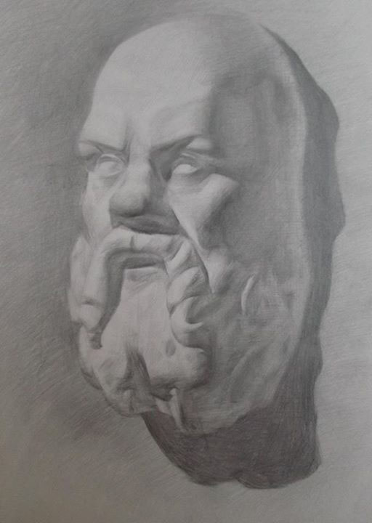
The Unexamined Lesson is Not Worth Giving
The Socratic Method in Library instruction
By Professor Bill Blick

Slide 2
What’s It all About?
Very often Information Literacy “One Shots” Fail because student’s do not grasp the “Big Picture”
Before any class it is good to start with open ended “Socratic Questions”

Slide 3
The Socratic Method: A Working Definition
a process of questioning used to successfully lead a person to knowledge through small steps. This knowledge can be :
specific data,
training in approaches to problem solving,
or leading one to embrace a specific belief.
the Socratic Method is a tool used to engage a large group of students in a discussion,
using probing questions to get at the heart of the subject matter.
The Socratic Method is not used to intimidate, nor to "break down" new students, but instead for the very reason Socrates developed it: to develop critical thinking skills in students and enable them to approach subject matter more in-depth (https://www.law.uchicago.edu/socratic-method)

Slide 4
The Method Continued
to help people do their own thinking in a way that lead to the birth of their own new ideas
This examination involved Socrates asking more questions, which help the respondents think critically about their previous answers.

Slide 5
Never Underestimate Open Discussion
Always incorporate open-ended guided discussions about the library
Adds a little humanity and a face to rows of books and lists of databases

Slide 6
There is no “how” without a “why”
Teaching students hard research skills is futile if they do not know why they are searching what they are searching.

Slide 7
Critical thinking about MIL
MIL: Media and Information Literacy
College is about CRTICAL THINKING
We need to provide the how and where tools, but also provide the why?
Socratic questioning provides this.

Slide 8
Time Management
How do I fit a discussion into a skills based class?
Can either lengthen a class
Create credit bearing classes on information

Slide 9
Questions
What is a library?
Why is it useful?
How many have ever been into library before now?
Why is critical thinking important?
What is information literacy?
Why is it useful?
What role does critical thinking play in information literacy?

